Slide 1
Mixed Integer Nonlinear programming (MINLP) using GAMS and Pyomo

Slide 2
Agenda
Review mixed integer nonlinear programming
Example 1 (Power scheduling problem)
Coding in GAMS
Coding in Python
Example 2 (Agricultural pricing problem)
Coding in GAMS
Coding in Python
Example 3 (Yield management problem)
Coding in GAMS
Coding in Python

Slide 3


Review mixed integer nonlinear programming
Mixed integer nonlinear programming (MINLP)
f, h, and g
x has at least one integer variable
subject to
Notes:
Please change and add detail as required, thank you!

Slide 4

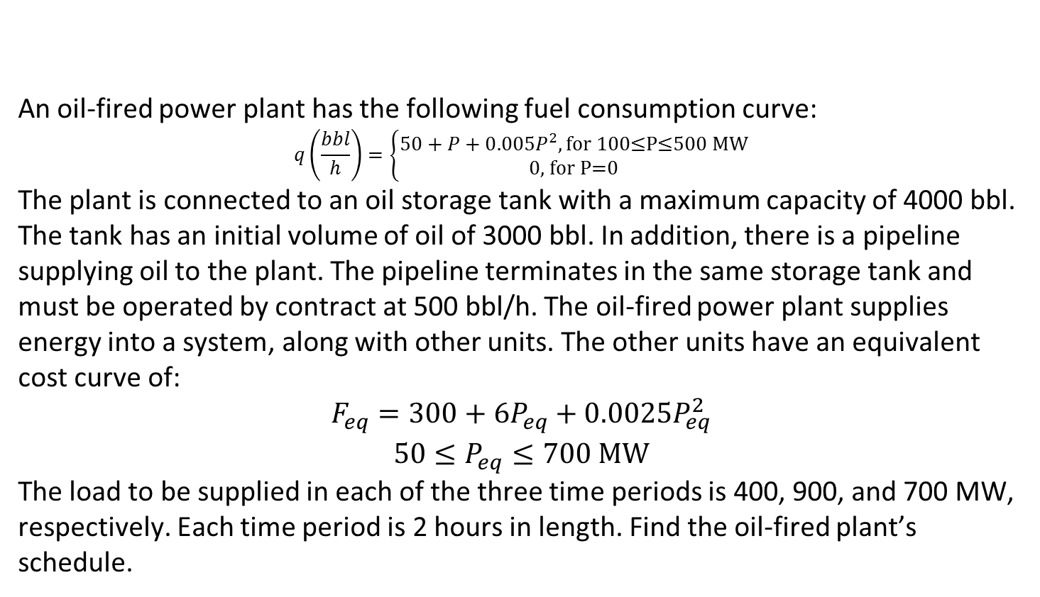
Example 1* - Power scheduling problem
An oil-fired power plant has the following fuel consumption curve:
$$q\left(\frac{bbl}{h}\right)=\left\{\begin{matrix}50+P+0.005P^{2}, \text{f}\text{or}\text{ 100≤}\text{P}\text{≤500 }\text{MW} \\ 0\text{, }\text{for} \text{P}\text{=0}\end{matrix}\right.$$
The plant is connected to an oil storage tank with a maximum capacity of 4000 bbl. The tank has an initial volume of oil of 3000 bbl. In addition, there is a pipeline supplying oil to the plant. The pipeline terminates in the same storage tank and must be operated by contract at 500 bbl/h. The oil-fired power plant supplies energy into a system, along with other units. The other units have an equivalent cost curve of:
$$\begin{matrix}F_{eq}=300+6P_{eq}+0.0025P_{eq}^{2} \\ 50≤P_{eq}≤700 \text{MW}\end{matrix}$$
The load to be supplied in each of the three time periods is 400, 900, and 700 MW, respectively. Each time period is 2 hours in length. Find the oil-fired plant’s schedule.

Slide 5
Organizing information – sets
Set of all time periods

Slide 6

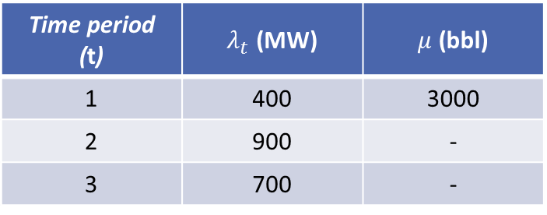
Organizing information – parameters (1)
Let $λ_{t}$ be the system load in each time period (in MW)
Let $μ$ be the initial level of oil in the storage tank at the beginning of time period 1 (in bbl)
Time period (t) | $λ_{t}$ (MW) | $μ$ (bbl)
1 | 400 | 3000
2 | 900 | -
3 | 700 | -

Slide 7
Organizing information – variables (1)
Status of the operation of oil-based generation unit in each period – binary variable
Volume of oil in storage tank in each time period – positive continuous variable
Oil consumption in each time period – positive continuous variable

Slide 8
Organizing information – variables (2)
Power generated by other units in each period – positive continuous variable
Power generated by oil-based generation unit in each period – positive continuous variable

Slide 9
Organizing information – objective function
Maximize: total cost of power generation
Objective function:

Slide 10
Organizing information – constraints (1)
Minimum level of power generation by oil-based generation unit in each period
Maximum level of power generation by oil-based generation unit in each period
Volume balance for oil storage tank:
In time period 1 –
In time period > 1 –
(eq1)
(eq2)
(eq3a)
(eq3b)

Slide 11
Organizing information – constraints (2)
Calculation of oil consumption in each period
Total power generated by oil-based, as well as other generation units must meet the demand in each period
(eq4)
(eq5)

Slide 12
Assembling optimization model
(eq1)
(eq2)
(eq3a)
(eq3b)
(eq4)
(eq5)

Slide 13
Example 2* - Agricultural pricing problem (1)
The government of a country wants to decide what prices should be charged for its dairy products: milk, butter, and cheese. All these products are produced (directly or indirectly) from the country’s raw milk production operations. This raw milk is divided into two main components: fat and dry matter. After subtracting the quantities of fat and dry matter, which are used for making products for export or consumption on the farms, there is a total yearly availability of 121,000 tons of fat and 250,000 tons of dry matter. This is all available for producing milk, butter and two kinds of cheese for domestic consumption. The goal is to determine what prices and demand maximizes the total revenue.
Product | Fat (%) | Dry matter (%)
Milk | 4 | 9
Butter | 80 | 2
Cheese 1 | 35 | 30
Cheese 2 | 25 | 40

Slide 14
Example 2 - Agricultural pricing problem (2)
Previous year’s data | Product
 | Milk | Butter | Cheese 1 | Cheese 2
Demand (in 1000s of tons) | 2055 | 54 | 63 | 17
Price (in ₤/ton) | 400 | 4000 | 3250 | 2500
 |  | Milk | Butter | Cheese 1 | Cheese 2
Elasticity |  | 0.3 | 1.5 | 0.7 | 0.4
Cross Elasticity | Milk | - | - | - | -
 | Butter | - | - | - | -
 | Cheese 1 | - | - | - | 0.06
 | Cheese 2 | 0 | 0 | 0.3 | 0
Policy constraint coefficient |  | 6.4 | 1.6 | 1.6 | 0.4

Slide 15
Organizing information – sets
Set of products

Slide 16
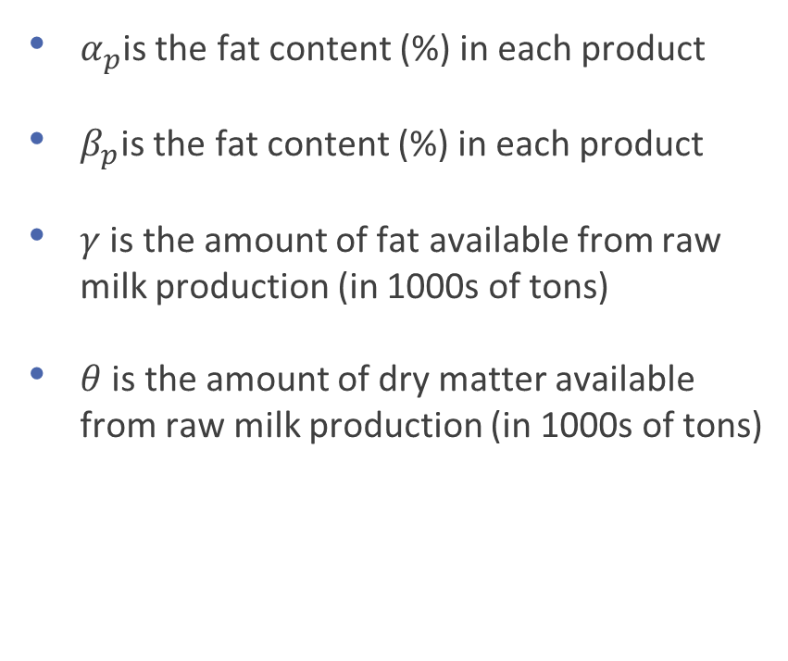
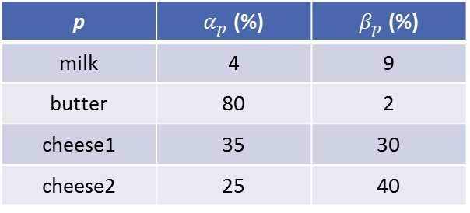
Organizing information – parameters (1)
$α_{p}$is the fat content (%) in each product
$β_{p}$is the fat content (%) in each product
$γ$ is the amount of fat available from raw milk production (in 1000s of tons)
$θ$ is the amount of dry matter available from raw milk production (in 1000s of tons)
p | $α_{p}$ (%) | $β_{p}$ (%)
milk | 4 | 9
butter | 80 | 2
cheese1 | 35 | 30
cheese2 | 25 | 40

Slide 17

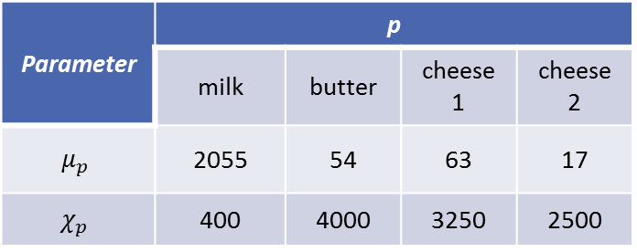
Organizing information – parameters (2)
$μ_{p}$is the average consumption of products in the previous year (in 1000s of tons)
$χ_{p}$is the average price of products in the previous year (in 1000s of ₤)
Parameter | p
 | milk | butter | cheese1 | cheese2
$$μ_{p}$$ | 2055 | 54 | 63 | 17
$$χ_{p}$$ | 400 | 4000 | 3250 | 2500

Slide 18
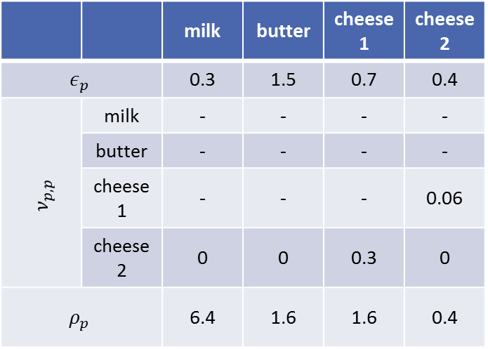
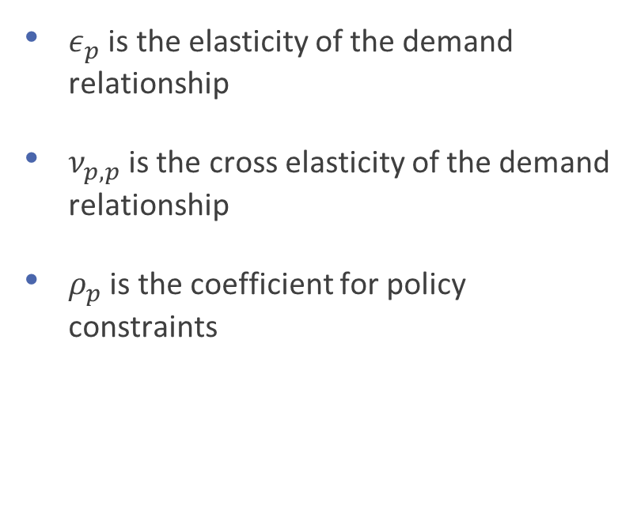
Organizing information – parameters (3)
$ε_{p}$ is the elasticity of the demand relationship
$ν_{p,p}$is the cross elasticity of the demand relationship
$ρ_{p}$ is the coefficient for policy constraints
 |  | milk | butter | cheese1 | cheese2
$$ε_{p}$$ |  | 0.3 | 1.5 | 0.7 | 0.4
$$ν_{p,p}$$ | milk | - | - | - | -
 | butter | - | - | - | -
 | cheese1 | - | - | - | 0.06
 | cheese2 | 0 | 0 | 0.3 | 0
$$ρ_{p}$$ |  | 6.4 | 1.6 | 1.6 | 0.4

Slide 19
Organizing information – variables
Amount of each product p consumed (in 1000s of tons) – integer variable
Price of each product p (in 1000s of ₤) – non-negative-continuous variable

Slide 20
Organizing information – objective function
Maximize: total revenue
Objective function:

Slide 21
Organizing information – constraints (1)
Fat content constraint
Dry matter content constraint
(eq1)
(eq2)

Slide 22
Organizing information – constraints (2)
Linear demand relationship for milk
Linear demand relationship for butter
(eq3)
(eq4)

Slide 23
Organizing information – constraints (3)
Linear demand relationship for cheese1
Linear demand relationship for cheese2
(eq5)
(eq6)

Slide 24
Organizing information – constraints (4)
Policy constraint
(eq7)

Slide 25
Assembling optimization model
(eq1)
(eq2)
(eq3)
(eq4)
(eq5)
(eq6)
(eq7)

Slide 26
Example 3* - Yield management problem (1)
An airline is selling tickets for flights to a particular destination. The flights will depart in three weeks and require up to six planes, each costing £50000 to hire. Each plane has the following: 37 first class seats, 38 business class seats, and 47 economy class seats. The airline needs to decide on an initial price for each of these seats, and will then have the opportunity to update the price after one week and two weeks. For administrative simplicity, three price level options are possible in each class (one of which must be chosen). The same option need not be chosen for each class. Demand forecasts have been made according to a probability distribution that divides the demand levels into three scenarios for each period.
The goal is to determine the price levels at the current point in time (three weeks before takeoff), how many seats to sell in each class, the provisional number of planes to book and provisional price levels and seats to sell in future periods in order to maximize expected yield. We should be able to meet commitments under all possible combinations of scenarios.

Slide 27
Example 3 - Yield management problem (2)
Ticket class | Price option (₤) |  |  | Time period
 | Option 1 | Option 2 | Option 3
First | 1200 | 1000 | 950 | Period 1
Business | 900 | 800 | 600
Economy | 500 | 300 | 200
First | 1400 | 1300 | 1150 | Period 2
Business | 1100 | 900 | 750
Economy | 700 | 400 | 350
First | 1500 | 900 | 850 | Period 3
Business | 820 | 800 | 500
Economy | 480 | 470 | 450
Demand scenario | Probability of occurrence
Scenario 1 | 0.1
Scenario 2 | 0.7
Scenario 3 | 0.2

Slide 28
Example 3 - Yield management problem (3)
Ticket class | Price option (₤) |  |  | Time period
 | Option 1 | Option 2 | Option 3
First | 10 | 15 | 20 | Period 1, Scenario 1
Business | 20 | 25 | 35
Economy | 45 | 55 | 60
First | 20 | 25 | 35 | Period 1, Scenario 2
Business | 40 | 42 | 45
Economy | 50 | 52 | 63
First | 45 | 50 | 60 | Period 1, Scenario 3
Business | 45 | 46 | 47
Economy | 55 | 56 | 64
Ticket class | Price option (₤) |  |  | Time period
 | Option 1 | Option 2 | Option 3
First | 20 | 25 | 35 | Period 2, Scenario 1
Business | 42 | 45 | 46
Economy | 50 | 52 | 60
First | 10 | 40 | 50 | Period 2, Scenario 2
Business | 50 | 60 | 80
Economy | 60 | 65 | 90
First | 50 | 55 | 80 | Period 2, Scenario 3
Business | 20 | 30 | 50
Economy | 10 | 40 | 60

Slide 29
Example 3 - Yield management problem (4)
Ticket class | Price option (₤) |  |  | Time period
 | Option 1 | Option 2 | Option 3
First | 30 | 35 | 40 | Period 3, Scenario 1
Business | 40 | 50 | 55
Economy | 50 | 60 | 80
First | 30 | 40 | 60 | Period 3, Scenario 2
Business | 10 | 40 | 45
Economy | 50 | 60 | 70
First | 50 | 70 | 80 | Period 3, Scenario 3
Business | 40 | 45 | 60
Economy | 60 | 65 | 70

Slide 30
Organizing information – sets
Set of classes in the plane
Set of price level options
Set of demand scenarios

Slide 31

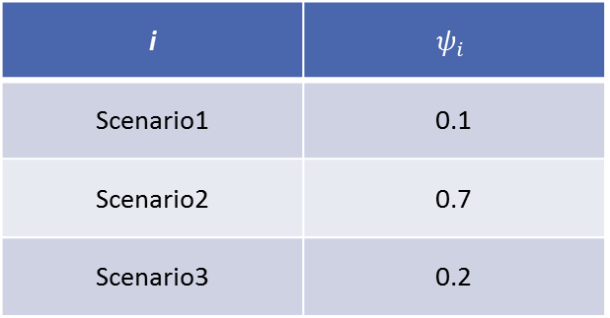
Organizing information – parameters (1)
$ψ_{i}$ is the probability of occurrence of each demand scenario i
i | $$ψ_{i}$$
Scenario1 | 0.1
Scenario2 | 0.7
Scenario3 | 0.2

Slide 32

Organizing information – parameters (2)
$δ_{i,c,h}^{1}$ is the demand for week 1 for class c under price h under demand scenario i
c | h |  |  | i
 | Option1 | Option2 | Option3
First | 10 | 15 | 20 | Scenario1
Business | 20 | 25 | 35
Economy | 45 | 55 | 60
First | 20 | 25 | 35 | Scenario2
Business | 40 | 42 | 45
Economy | 50 | 52 | 63
First | 45 | 50 | 60 | Scenario3
Business | 45 | 46 | 47
Economy | 55 | 56 | 64

Slide 33

Organizing information – parameters (3)
$δ_{i,c,h}^{2}$ is the demand for week 2 for class c under price h under demand scenario i
c | h |  |  | i
 | Option1 | Option2 | Option3
First | 20 | 25 | 35 | Scenario1
Business | 42 | 45 | 46
Economy | 50 | 52 | 60
First | 10 | 40 | 50 | Scenario2
Business | 50 | 60 | 80
Economy | 60 | 65 | 90
First | 50 | 55 | 80 | Scenario3
Business | 20 | 30 | 50
Economy | 10 | 40 | 60

Slide 34

Organizing information – parameters (4)
$δ_{i,c,h}^{3}$ is the demand for week 3 for class c under price h under demand scenario i
c | h |  |  | i
 | Option1 | Option2 | Option3
First | 30 | 35 | 40 | Scenario1
Business | 40 | 50 | 55
Economy | 50 | 60 | 80
First | 30 | 40 | 60 | Scenario2
Business | 10 | 40 | 45
Economy | 50 | 60 | 70
First | 50 | 70 | 80 | Scenario3
Business | 40 | 45 | 60
Economy | 60 | 65 | 70

Slide 35

Organizing information – parameters (5)
$π_{c,h}^{1}$ is the price for class c under option h in week 1
 | Option1 | Option2 | Option3
First | 1200 | 1000 | 950
Business | 900 | 800 | 600
Economy | 500 | 300 | 200

Slide 36

Organizing information – parameters (6)
$π_{c,h}^{2}$ is the price for class c under option h in week 2
 | Option1 | Option2 | Option3
First | 1400 | 1300 | 1150
Business | 1100 | 900 | 750
Economy | 700 | 400 | 350

Slide 37

Organizing information – parameters (7)
$π_{c,h}^{3}$ is price for class c under option h in week 3
 | Option1 | Option2 | Option3
First | 1500 | 900 | 850
Business | 820 | 800 | 500
Economy | 480 | 470 | 450

Slide 38
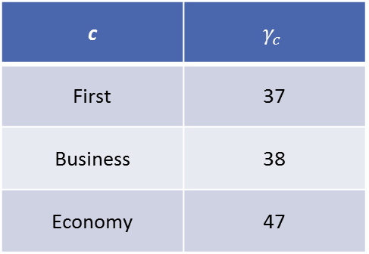

Organizing information – parameters (8)
$γ_{c}$ is the seat capacity for each ticket class c
c | $$γ_{c}$$
First | 37
Business | 38
Economy | 47

Slide 39
Organizing information – variables (1)
Whether or not price option h is chosen for ticket class c in week 1 – binary variable
Whether or not price option h is chosen for ticket class c in week 1 – binary variable
Whether or not price option h is chosen for ticket class c in week 1 – binary variable

Slide 40
Organizing information – variables (2)
Number of tickets sold for class c under demand scenario i in week 1 – nonnegative variable
Number of tickets sold for class c under demand scenario i in week 1, and ii in week 2 – nonnegative variable
Number of tickets sold for class c under demand scenario i in week 1, ii in week 2, and iii in week 3 – nonnegative variable

Slide 41
Organizing information – variables (3)
Number of planes hired to fly
Number of planes available for hire:

Slide 42
Organizing information – objective function
Maximize: total revenue from ticket sales in weeks 1, 2, and 3
Objective function:

Slide 43
Organizing information – constraints (1)
Only one price option must be chosen in week 1
Sales must not exceed demand in week 1
(eq1a)
(eq1b)

Slide 44
Organizing information – constraints (2)
Only one price option must be chosen in week 2
Sales must not exceed demand in week 2
(eq2a)
(eq2b)

Slide 45
Organizing information – constraints (3)
Only one price option must be chosen in week 3
Sales must not exceed demand in week 3
(eq3a)
(eq3b)

Slide 46
Organizing information – constraints (4)
Seat capacity must be abided by

Slide 47
Assembling optimization model
(eq1a)
(eq1b)
(eq2a)
(eq2b)
(eq3a)
(eq3b)
(eq4)

Slide 48
Summary
In this section, we learnt
The general structure of a mixed integer nonlinear optimization problem
Introduction to coding simple MINLP models in GAMS and Pyomo
Importing data into Pyomo and GAMS

